Slide 1

Final Project: PBMC Single-Cell Classification Pipeline
Kristof Torkenczy

Slide 2
Background of single-cell sequencing
Bulk sequencing limitations: Older methods averaged genetic signals from mixed cell populations.
Single-cell revolution: Microfluidics now allow RNA/DNA measurement in individual cells, revealing tissue complexity and disease mechanisms.
scRNA-seq workflow: Cell isolation → RNA capture with cell IDs → genome alignment → gene-by-cell raw counts matrix.
Data characteristics: Highly sparse (~90% zeros), requiring feature selection, PCA, clustering, and UMAP for structure discovery.
Cell type identification: Traditionally done via manual marker-gene annotation—labor intensive.
ML approaches: Transfer learning used to automate cell type annotation from reference datasets to new ones.
Benchmark dataset: Peripheral blood mononuclear cells (PBMC) — well-studied, easily obtained, ideal for classification experiments

Slide 3

Objective
Build a comprehensive machine learning pipeline for automated cell type identification in PBMC single-cell RNA sequencing data using marker-based annotation.

Slide 4
Datasets
PBMC 3k (Training) – 10x Genomics v1, ~2.7k cells × 32.7k genes, well-characterized reference dataset.
PBMC Multiome (Test) – 10x Multiome ATAC+RNA, ~11.9k cells × 36.6k RNA genes, granulocyte-sorted.
PBMC 10k v3 (Test) – 10x v3, ~11.8k cells × 33.5k genes, standard RNA-only dataset.

Slide 5
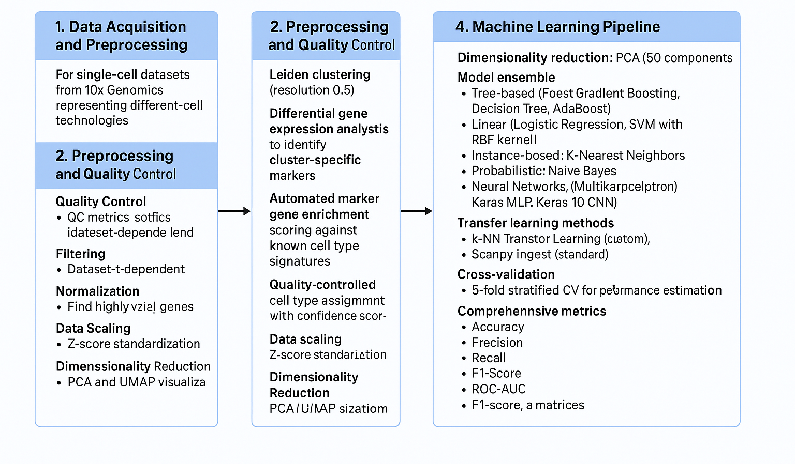
Methodology

Slide 6
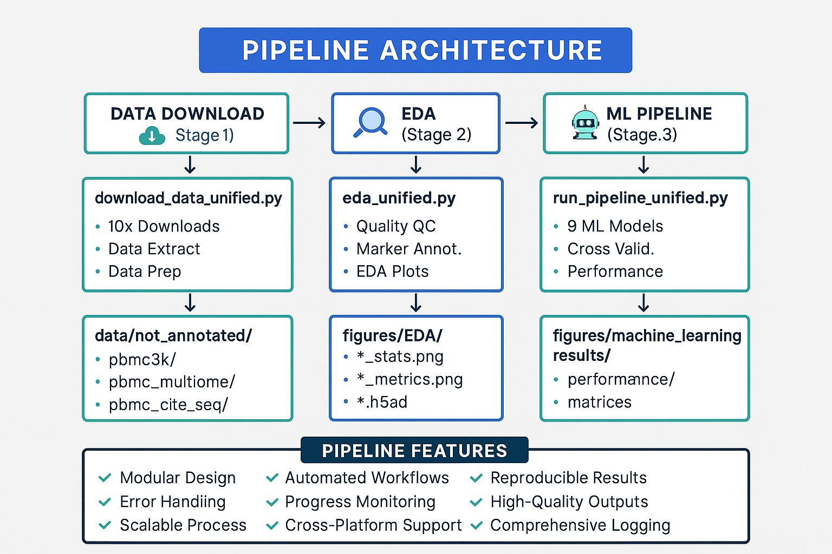
Pipeline

Slide 7
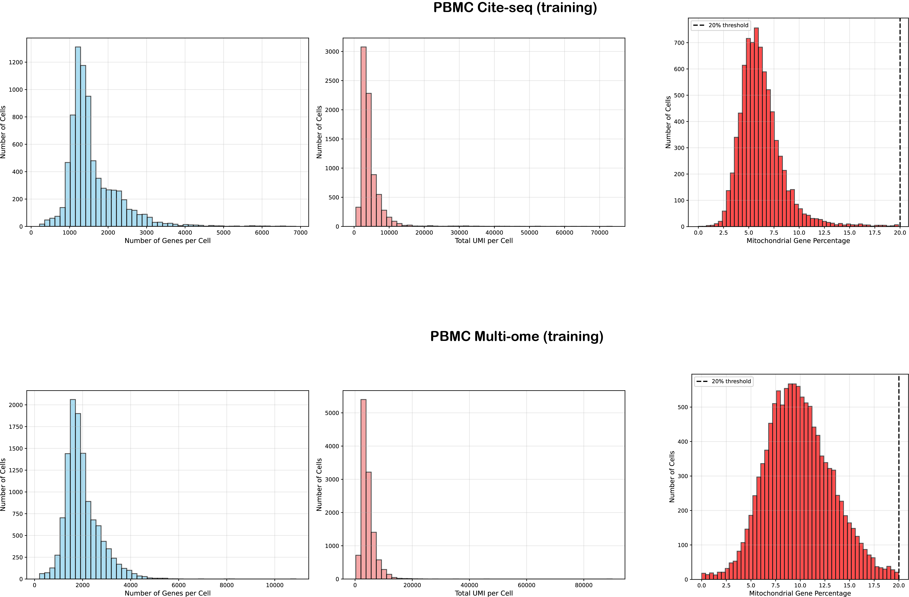
Preprocessing and explorative analysis
Quality Control: Compute metrics like genes per cell, total reads per cell, and mitochondrial gene percentage.
Filtering: Remove lowly expressed genes (<200 reads), low-quality cells (<500 reads), and cells with high mitochondrial content (>20%).
Normalization: Adjust counts for sequencing depth (e.g., scale to 10k reads) and apply log1p transform to stabilize variance.
Feature Selection: Identify highly variable genes using variance–mean modeling.
Data Scaling: Apply Z-score standardization with max value clipping.
Dimensionality Reduction: Use PCA and UMAP for visualization.

Slide 8
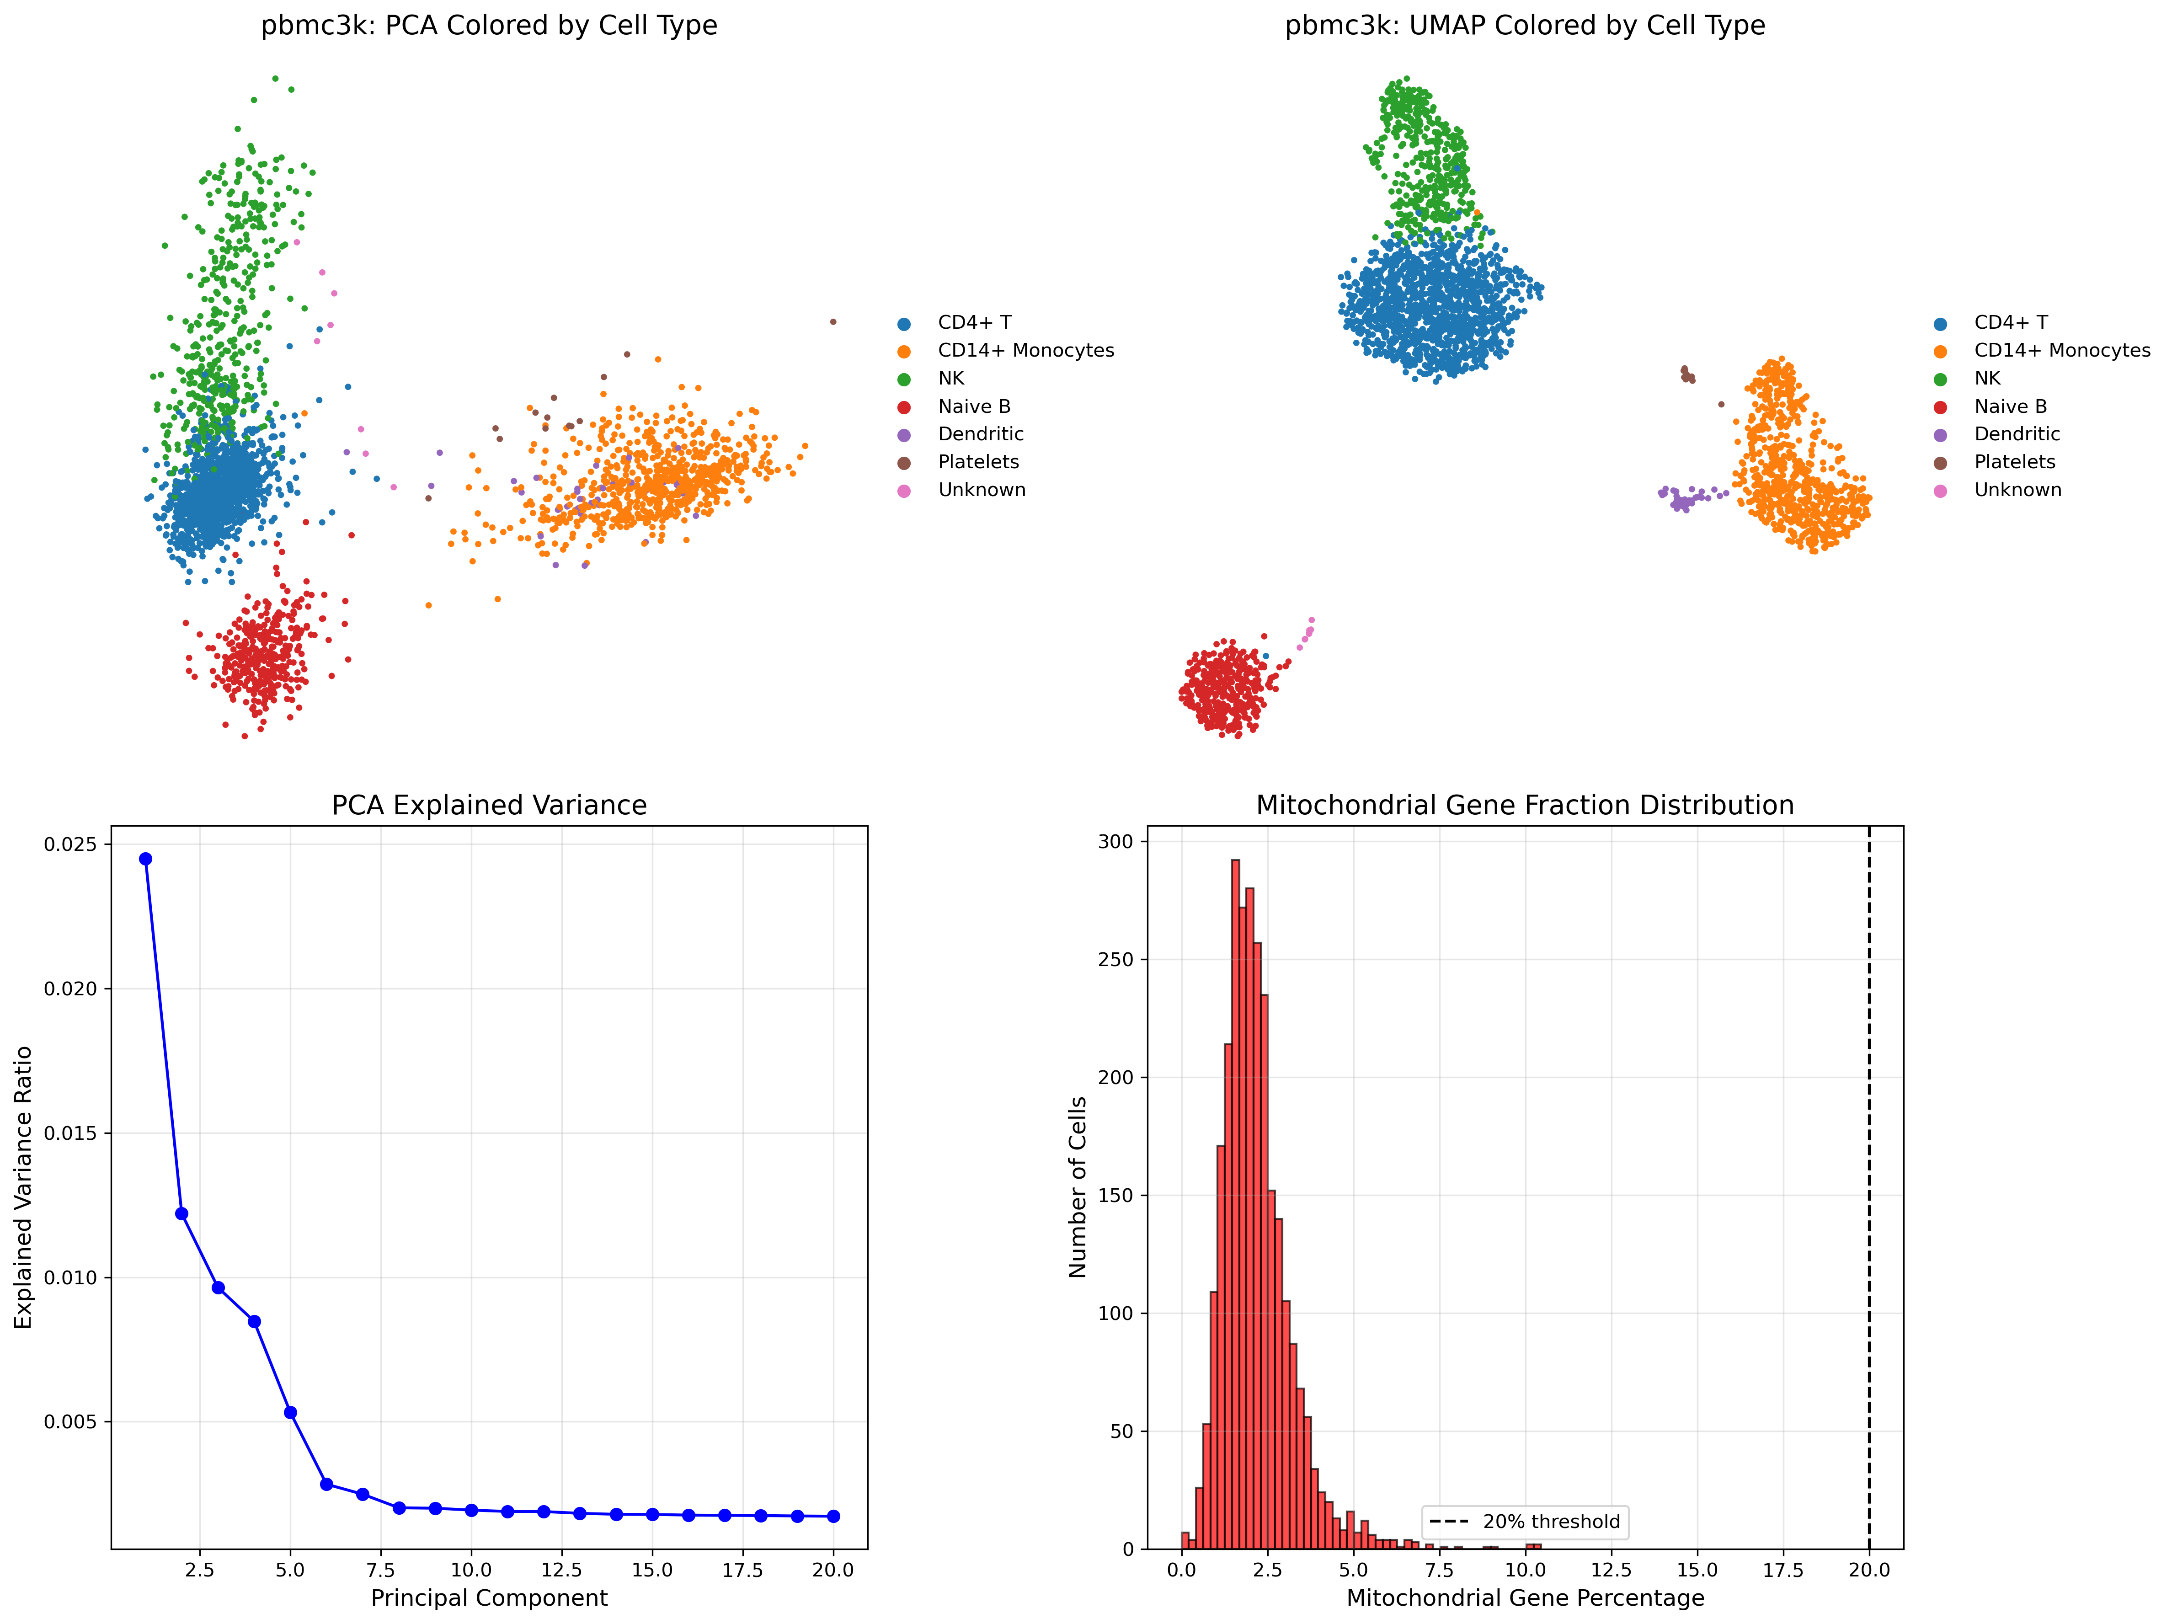
Preprocessing and explorative analysis
Quality Control: Compute metrics like genes per cell, total reads per cell, and mitochondrial gene percentage.
Filtering: Remove lowly expressed genes (<200 reads), low-quality cells (<500 reads), and cells with high mitochondrial content (>20%).
Normalization: Adjust counts for sequencing depth (e.g., scale to 10k reads) and apply log1p transform to stabilize variance.
Feature Selection: Identify highly variable genes using variance–mean modeling.
Data Scaling: Apply Z-score standardization with max value clipping.
Dimensionality Reduction: Use PCA and UMAP for visualization.

Slide 9
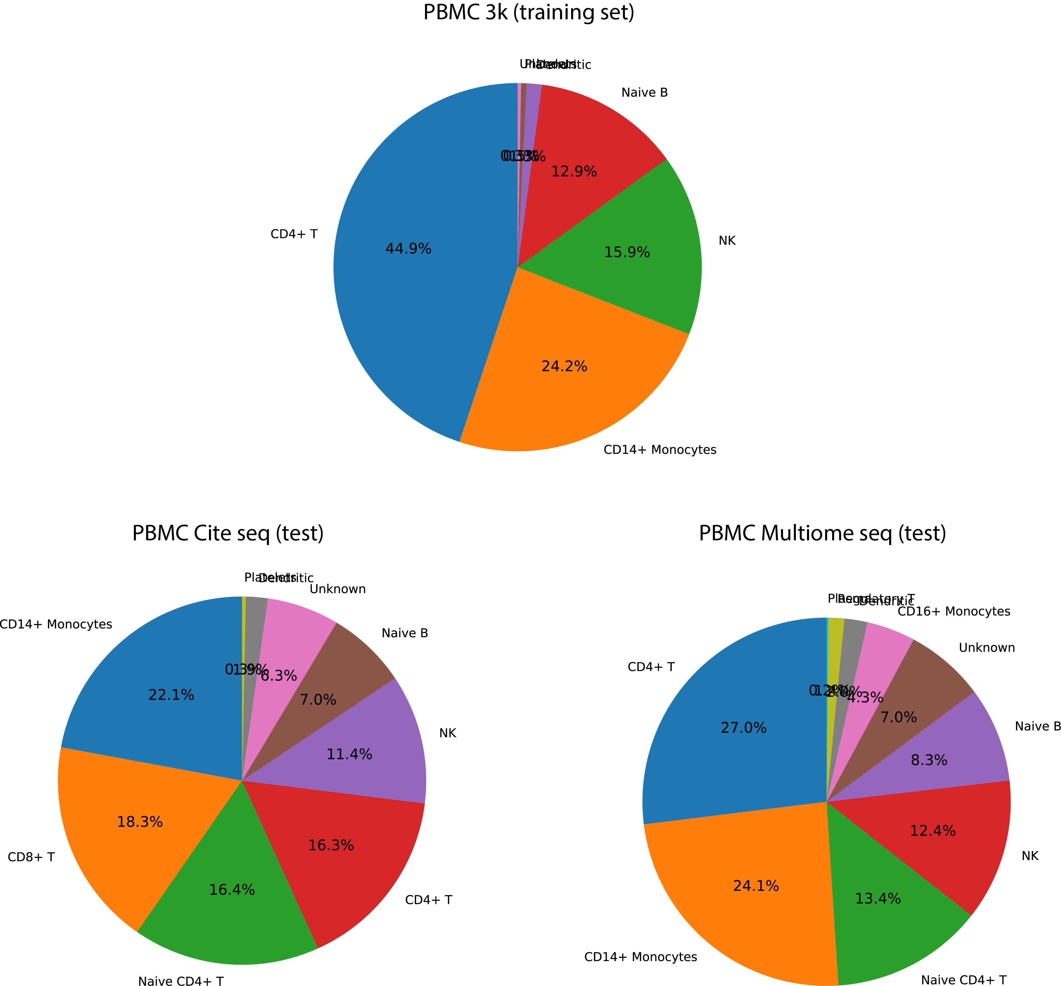
Preprocessing and explorative analysis
Cross sample harmonization: To compare cell types cross sample harmonization of labels was necessary

Slide 10
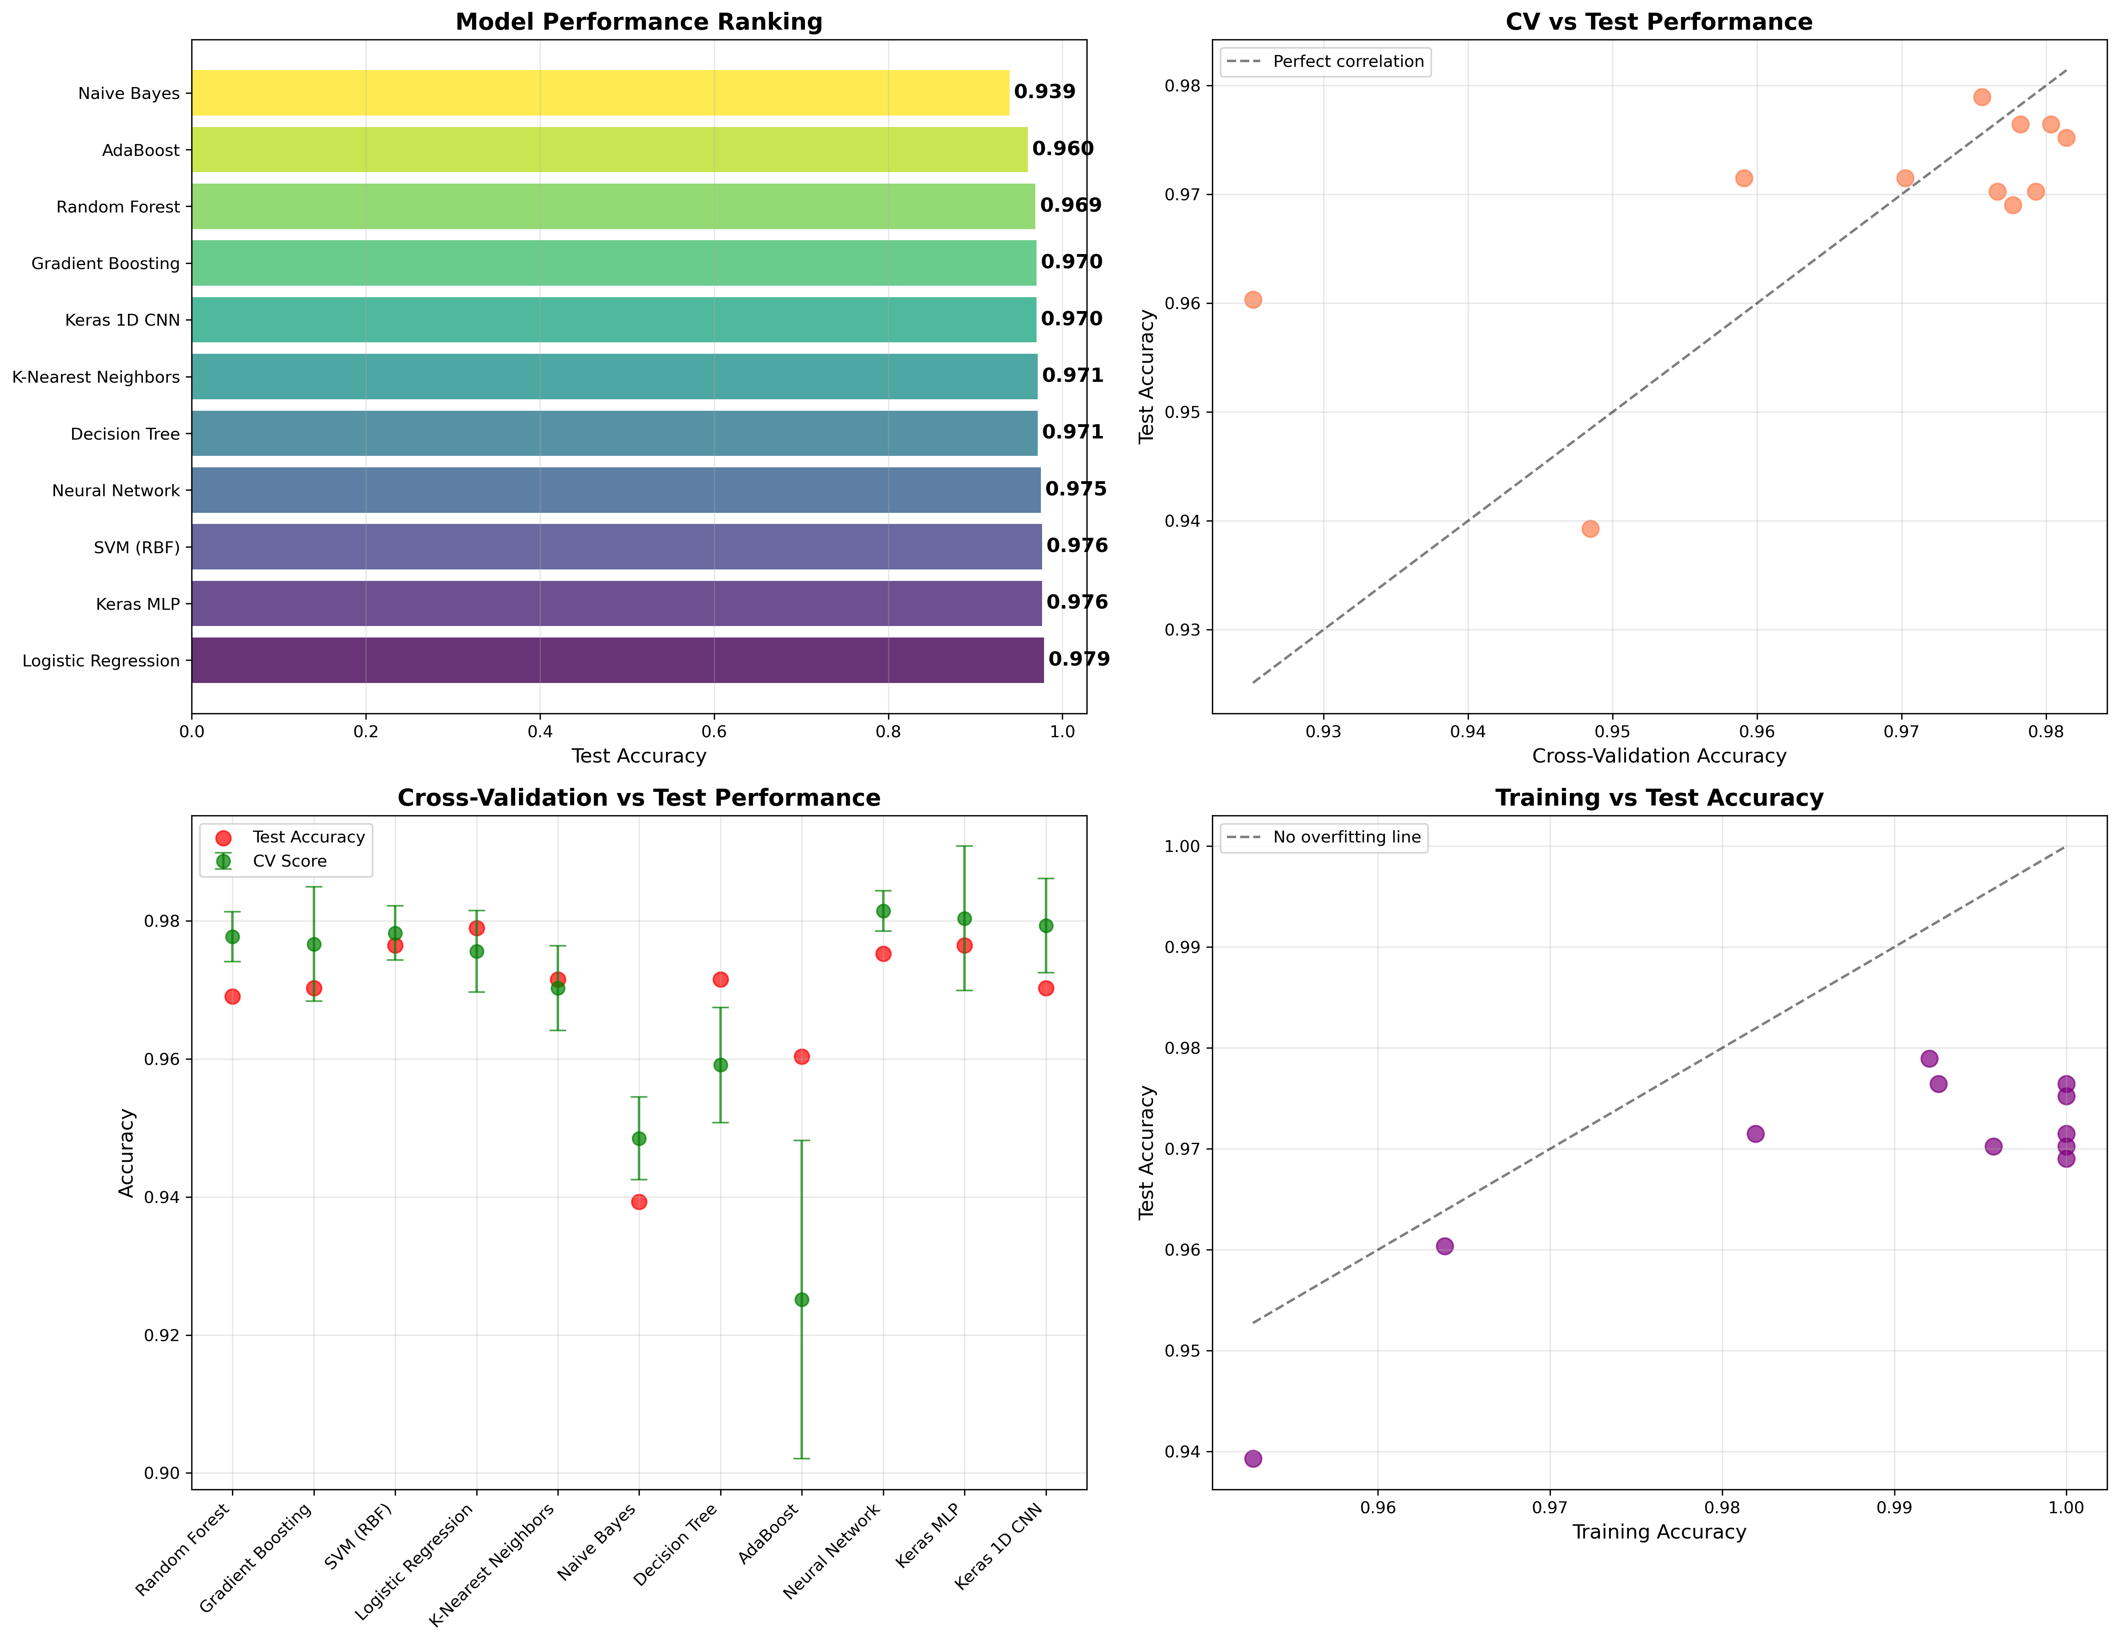
Machine learning, training sample
Logistic Regression leads: Achieves highest test accuracy (97.9%) with good test generalization. This still might be overfitting.
Consistent performance: Deep learning models show strong but slightly lower test accuracies. I wonder how they will generalize to other datasets.
Less overfitting: CV scores align well with test performance across all
models.
Robust classification: All top models achieve >97% accuracy with very
good ROC-AUC scores.

Slide 11
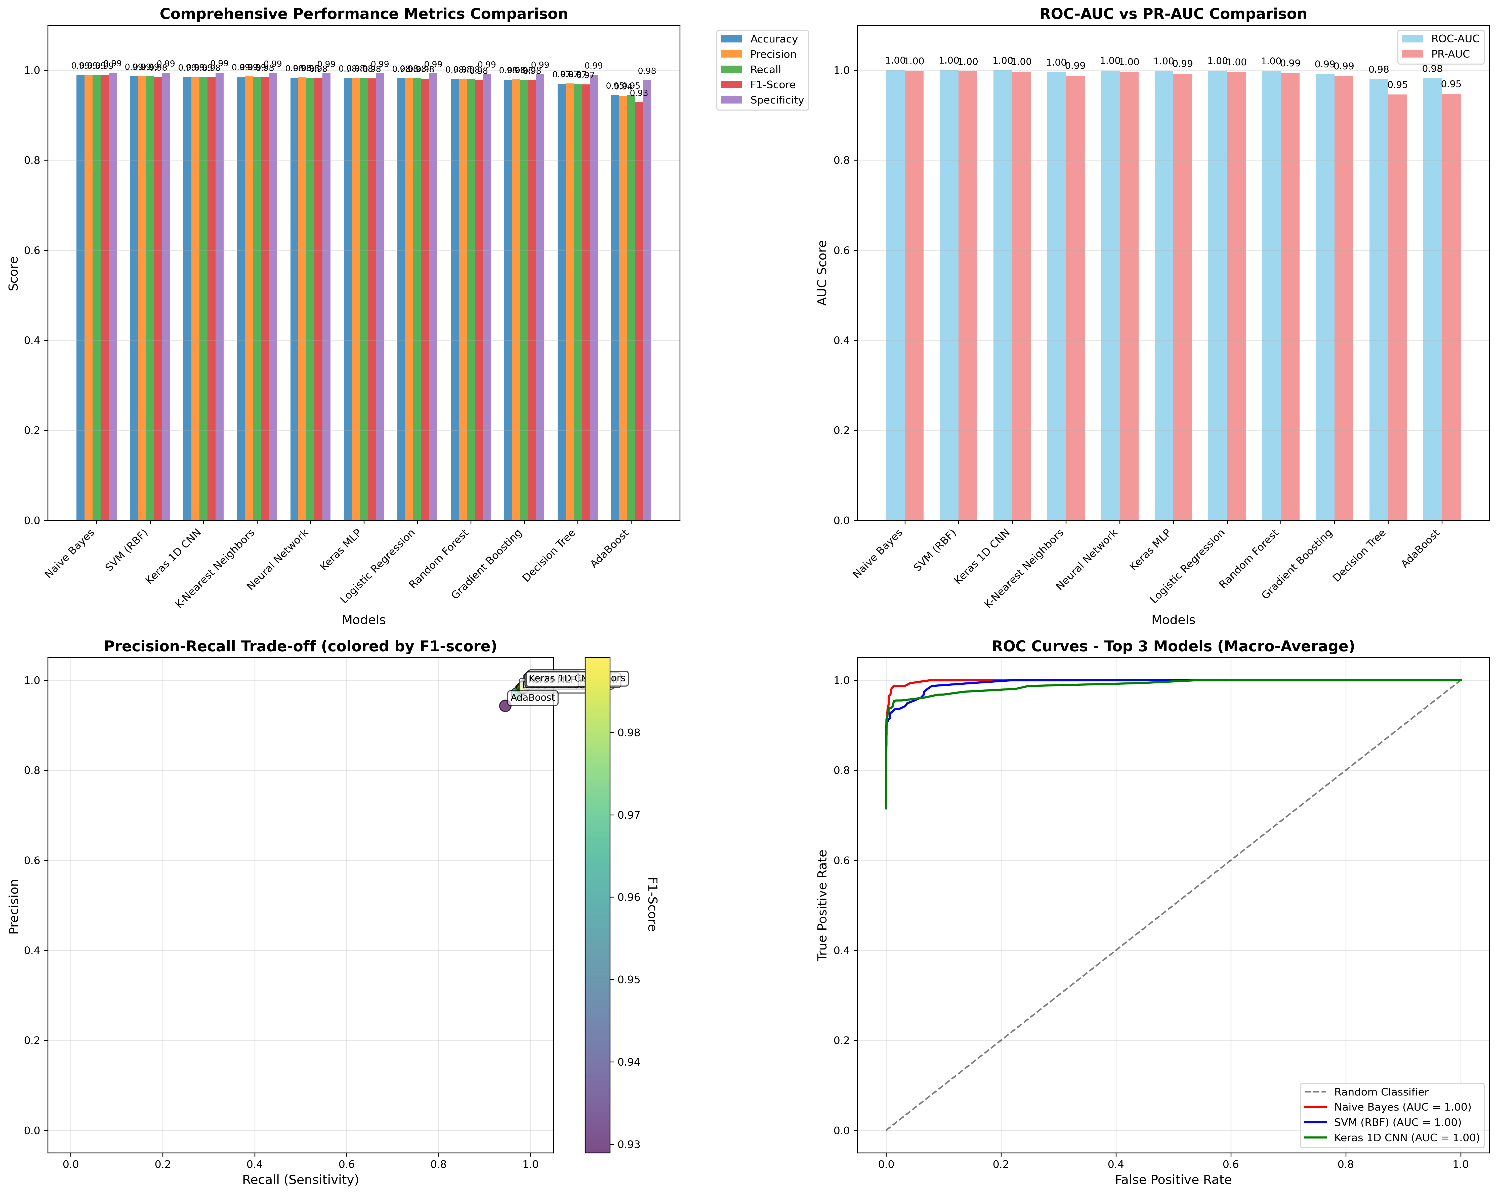
Machine learning, cross-samples (Cite-seq)
Naive bayes performs highest
Some worry we are overfitting on biology here

Slide 12
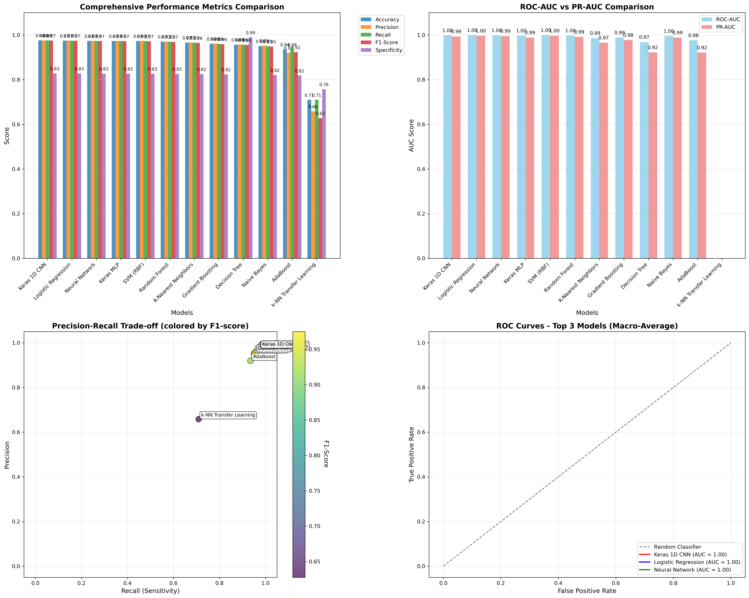
Machine learning, cross-samples (Multi-ome)
High F1:You have a good balance of precision and recall for the positive class. The model correctly identifies many true positives and doesn’t make too many false positives relative to the number of positives.
Lower specificity: The model is not as good at identifying negatives. It’s producing more false positives, which hurts its ability to correctly label negatives as negatives.

Slide 13
Transfer learning approaches
Gold standard at the moment in the field is manifold learning that transfer labels (e.g.: scanpy ingest). I tried to make my own and tested it against scanpy ingest:
Data Preparation:
Reference dataset (PBMC 3k) with known labels; query dataset (Multiome/CITE-seq) for prediction
Find common genes (~11.7k) between datasets
Feature Harmonization:
Use only intersecting genes
Z-score normalization for comparability
Map cell type labels to common categories (CD4+ T, CD8+ T, B, Monocytes, NK, DC, Other)
Similarity-Based Prediction (k-NN):
For each query cell, find k=15 most similar reference cells (Euclidean distance)
Distance-weighted voting for prediction
Assign cell type from majority of nearest neighbors

Slide 14
Transfer learning approaches
Method | CITE-seq Accuracy | Multiome Accuracy | Approach
k-NN Transfer Learning (Custom Implementation) | 53.3% | 65.9% | Raw expression similarity
Scanpy Ingest Transfer Learning (Standard Method) | 54.7% | 88.5% | State-of-the-art manifold mapping

Slide 15
Summary and future directions:
Cross-Dataset Analysis
High accuracy (97–99%) with Union HVG strategy
Platform robustness: CITE-seq (98.9%), Multiome (97.5%)
Transfer Learning
Traditional ML > Specialized transfer methods
Clean feature selection outperforms complex mapping approaches
Preprocessing matters: k-NN transfer (70.9% on Multiome) highlights impact of data prep
Note
Possible biological overfitting — further validation recommended
Added functionality to download pre-annotated datasets (see expert_annotations.ipynb)

